Slide 1
Attention in the Toy Model

Slide 2
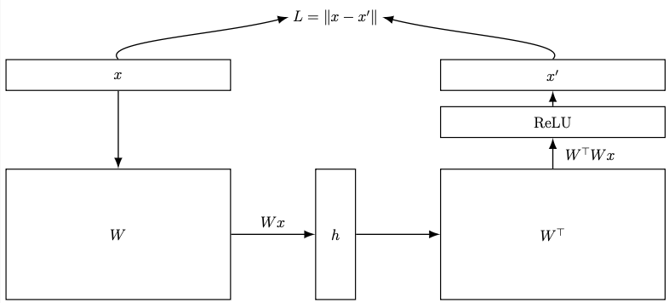
“Toy Models” Autoencoder
Features in x are all positive or zero, with some fixed sparsity

Slide 3
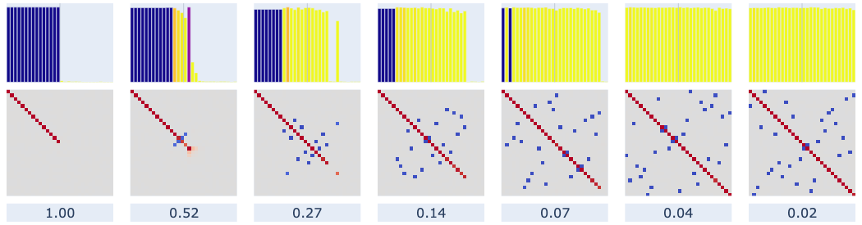
Recap of the “Toy Models” Results

Slide 4
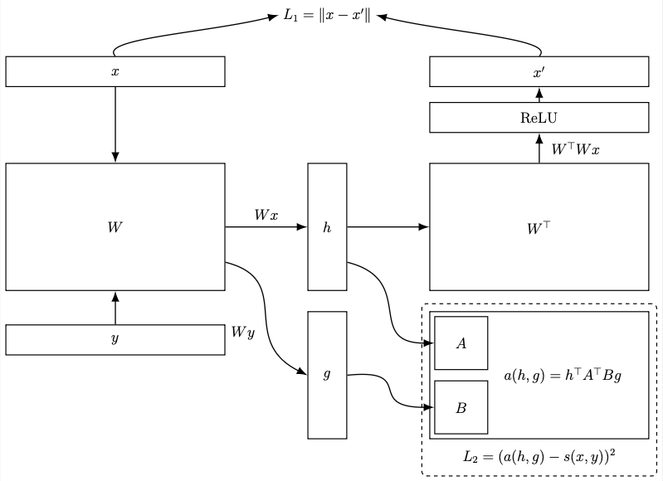


Adding a Toy Attention Head
a(h, g) is the model’s predicted logit for tokens h and g
Define a function s(x, y) which is the “target logit” for inputs x and y
a(h, g) is the model’s predicted logit
For example, assume we want the head to attend to only the token pair having feature i in the left input and feature j in the right input. Then we define

Slide 5
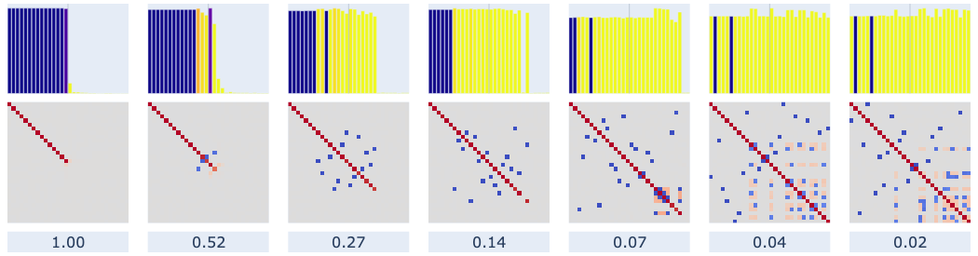
Effect of the Toy Attention Head
We associate features 1 and 5
t_{1,5} = 1, o/w t = 0
⇒ features remain orthogonally represented

Slide 6
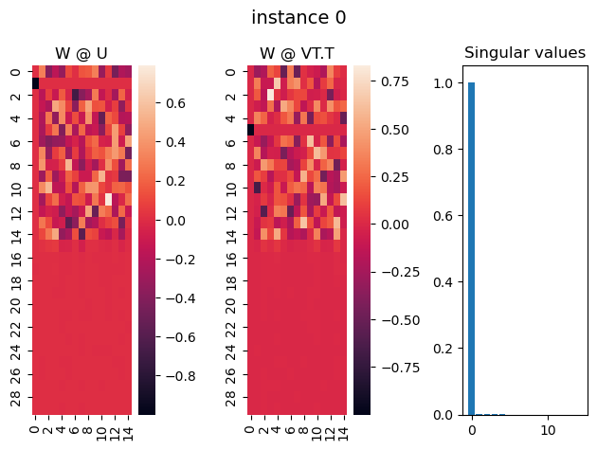
Features 1 and 5 recovered by the attention head’s SVD
Feature 1 is recovered by
left singular vector 0
Feature 5 is recovered by
right singular vector 0
Head only responds to
one dimension in input

Slide 7
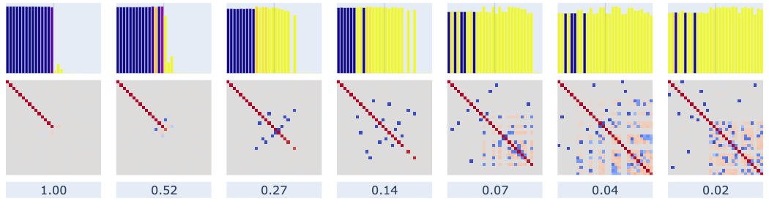
Associating multiple features (2 with 4, and 5 with 8)
t_{2,4} = 1
t_{5,8} = 2
Unless very sparse, all four are orthogonal to all
When very sparse, 4 loses orthogonality with feature 0
All 4 however remain mutually orthogonal

Slide 8
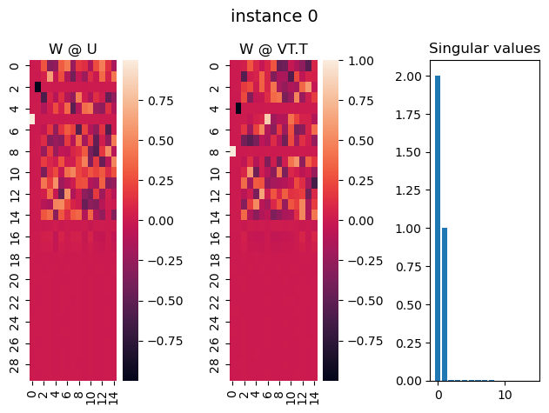
All four features recovered, low sparsity
t_{2,4} = 1
t_{5,8} = 2
Features 5 and 8 are allocated to first singular vector
Features 2 and 4 are allocated to second singular vector
Singular values are proportional to target logits!

Slide 9
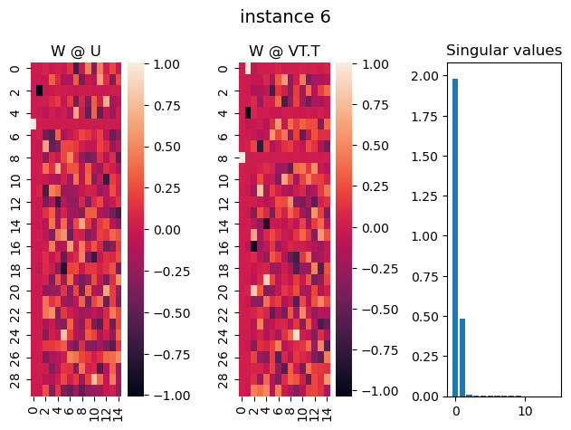
All four features recovered, high sparsity
s(2, 4) = 1
s(5, 8) = 2
Same allocation of features to singular vectors
Now, feature 4 has aligned with feature 0
Attention head does not respond b/c feature 0 points in opposite direction of SV2
But singular value is smaller because of interaction … (?)

